Slide 1
Programming With C++/R
DST102TC
Huakang Li
Huakang.li@xjtlu.edu.cn
School of AI and Advanced Computing
Notes:
English Title: Uppercase, Calibri size 60, XJTLU Navy
English Subtitle: Uppercase, Calibri size 36, XJTLU Navy

Slide 2
Chapter 0
Handbook
Notes:
English Title: Uppercase, Calibri size 60, XJTLU Navy
English Subtitle: Uppercase, Calibri size 36, XJTLU Navy

Slide 3
Brief Introduction
This module will focuses on the main modes of thinking about computer programming. It includes the basics of basic computer composition, data types, storage structures, computational logic, function calls and wrappers, and data input and output knowledges. The module also contains extensive practical programming content, mainly in C++ and R programming languages, to train students in practical skills.
The module content will enable students to develop their computational logic thinking and practical programming skills. This module is to provide students with a solid foundation of knowledge for their future practical work in Big Data area.

Slide 4

delivery schedule
Lectures
Time (Week 1 – Week 5) | Teaching mode: onsite/online Mon. SC169 / Tue. SB102 https://learningmall.xjtlu.edu.cn/ course/view.php?id=1388
Mon. 4-6:30pm
Tue. 5-7:30 pm
Labs
Time (Week 1 – Week 5) | Teaching mode: onsite
Mon. 11-1pmforClassGroup1/D1 | PB310
Thu. 4-7pm for Class Group 1/D2
Tue.1-3pmforClassGroup2/D1 | PB310
Fri. 2-5pm for Class Group 2/D2
Wed. 11-1pm for Class Group 3/D1 | PB310
Fri. 5-8pm for Class Group 3/D2
Seminar
Time (Week 6) | Teaching mode: online/onsite SA164 https://learningmall.xjtlu.edu.cn/ course/view.php?id=1388
Wed. 9-11am
Wed. 11-1pm

Slide 5
Learning Outcomes Assessment Details
Coursework assignment 1 (50%): submission deadline Friday 6th April 2021
Coursework assignment 2 (50%): submission deadline Friday 19th April 2021
Sequence | Method | Assessment Type | Learning outcomes assessed | Duration | Week | % of Final Mark | Resit(Y/N/S)³
001 | Assessment1 (Group) | CW | A, B, C, D |  |  | 50 | S
002 | Assessment1 | CW | ALL |  |  | 50 | S
R001 |  | CW | ALL |  |  | 100

Slide 6
Methods of learning and teaching
The teaching philosophy of the module follows very much the philosophy of Syntegrative Education. This has meant that the teaching delivery pattern, which follows more intensive block teaching, allows more meaningful contribution from industry partners. This philosophy is carried through also in terms of assessment, with reduction on the use of exams and increase in coursework, especially problem-based assessments that are project focused. The delivery pattern provides space in the semester for students to concentrate on completing the assessments.
This module will be delivered through a combination of formal lectures, seminars and supervised computer laboratory sessions.
The concepts introduced during the lecture are illustrated using step-by-step analysis of example code, complete case studies and live programming tutorials. Each week the students have to solve a set of exercises during the laboratory classes and submit the completed work electronically.
The students are assisted during the practical laboratory classes by demonstrators.

Slide 7
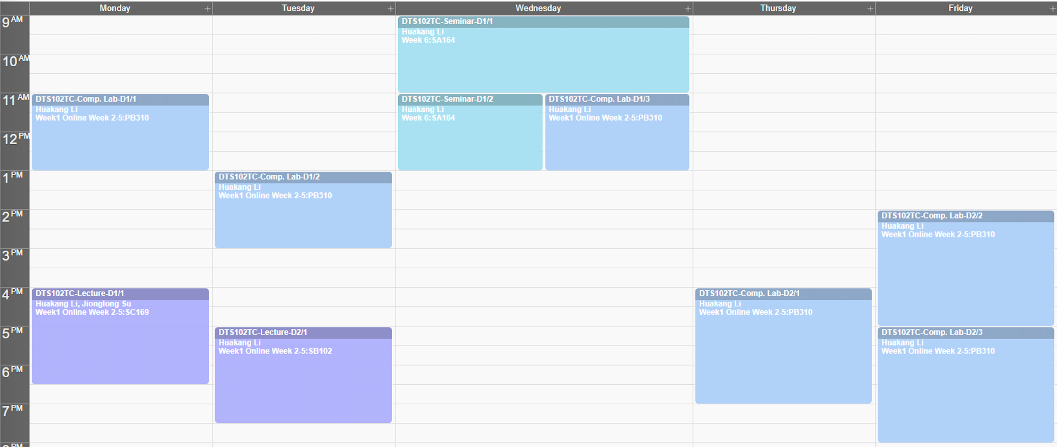
teaching plan

Slide 8






Teaching schedule
Week Number and/or Date | Lecture/Seminar/ Field Trip/Other | Topic/Theme/Title | Pre-reading
Week 1 Monday | Lecture 1 | Introduction to C++ | Ch1.1,1.2,1.3
 |  |  | Ch2.1, 2.3, 2.4~2.8
Week 1 Tuesday | Lecture 2 | Flow of Control | Ch3.2~3.9
 |  |  | Ch5.2~5.6
Week 2 Monday | Lecture 3 | Functions | Ch4.3~4.6
 |  |  | Ch6.2~6.8
Week 2 Tuesday | Lecture 4 | Classes & Objects | Ch9.2~9.6
 |  |  | Ch10.2~10.6
Week 3 Monday | Lecture 5 | Arrays & Pointes | Ch7.2~7.7
 |  |  | Ch11.2~11.5
Week 3 Tuesday | Lecture 6 | Friend & Inheritance | Ch14.7~14.9
 |  |  | Ch15.2~15.5
Week 4 Monday | Lecture 7 | Polymorphism | Ch15.6~15.9
 |  |  | Ch16.4~16.7
Week 4 Tuesday | Lecture 8 | R language syntax and control & data structures | R for Beginners
Week 5 Monday | Lecture 9 | Data import/export & Functions | Ch13.1~13.9
Week 5 Tuesday | Lecture 10 | Graphics & R Package | Ch24.2~24.6
 |  |  | R Ch13.1~13.3

Slide 9



Practical schedule
Week Number and/or Date | Practical | Topic/Theme/Title
Week 1 D1 | Lab 1 | C++ TutorialC++ Elementary Programming
Week 1 D2 | Lab 2 | C++ SelectionC++ Loops
Week 2 D1 | Lab 3 | C++ Characters C++ Function
Week 2 D2 | Lab 4 | C++ ClassC++ Objects
Week 3 D1 | Lab 5 | C++ ArrayC++ Points
Week 3 D2 | Lab 6 | C++ FriendsC++ Inheritance
Week 4 D1 | Lab 7 | C++ PolymorphismC++ Exception
Week 4 D2 | Lab 8 | R Tutorial
Week 5 D1 | Lab 9 | C++ InputC++ Output
Week 5 D2 | Lab 10 | C++ GraphR Package

Slide 10

Reading materials
Optional textbook is a book in print that students can choose to purchase or not.
Title | Author | ISBN/Publisher
Introduction to Programming With C++ | Y. Daniel Liang | 9780273793243/Pearson
Reference Textbooks
Title | Author | ISBN/Publisher
C++ FROM THE BEGINNING | J. SKANSHOLM | 9780201721683 /WEST
C++ HOW TO PROGRAM | PAUL DEITEL, HARVEY M. DEITEL | 9780136117261 /PRENTICE HALL
STARTING OUT WITH C++ FROM CONTROL STRUCTURES THROUGH OBJECTS | TONY GADDIS | 9781292119427 /PEARSON
Module handbook and other important resources
https://learningmall.xjtlu.edu.cn/mod/folder/view.php?id=58360

Slide 11



THANK YOU
Visit us
FOLLOW us
www.xjtlu.edu.cn
Notes:
Title: Uppercase, Calibri size 60, XJTLU Navy

